Slide 1
Welcome
to
Economic and Financial
Affairs Committee
Ohrid, Macedonia 2021

Slide 2
Agenda
01
02
Meet us
Introduction to today’s teambuilding workshop
03
04
Team building games
Conclusions
Who will lead you in today's games?
What are your expectations and our goals?
Acrostic Poem
Pictionary
Puzzles
Closing the workshop and reviewing expectations and goals

Slide 3
01
Meet
Us!
who are the girls who will lead teambuilding activities today?

Slide 4
Marija Buleska & Aleksandra Petreska
Students in the Ohrid gymnasium, in the fourth year.
We are graduating high school this year.
We love meeting new people
We like to learn more about the culture of others.
We were part of Erasmus +, visiting Bulgaria in May 2019

Slide 5
Write in a message or think of about your expectations for today's zoom workshop and present it.
Your expectations
My expectations for todays workshop is that by the end of it, hopefully everyone would feel more comfortable around new people, and everyone would feel free to share their opinions and stuff about themselves. – Marija
My expectation is that by the end of the day we will all have 18 new friends. And hopefully we will be great team! – Aleksandra

Slide 6
Оur goal
our main goals is simple! we want you to have fun, to meet and learn more about each of you and make a GREAT ERASMUS TEAM

Slide 7

Teambuilding games
A
B
C
Acrostic Poem
Puzzles
Pictionary
Learn more about your new friends in a fun way
Piece by piece, get a beautiful puzzle with the landscapes of Ohrid
Try to use your imagination and creativity

Slide 8
Activity 1:Acrostic Poem
Instructions
1. Use your first name to create a short poem.
2. In 10 minutes write your name vertically and use each letter to start a line, that describes something about yourself.
!! Keep in mind, that after you wrote your poems, you should present it to everyone.

Slide 9
EXAMPLES:
A- is for Adventures, wanting to try everything
L- is for sometimes Lazy
E- is for Enthusiastic about everything
K- is for Keen, an ever curious mind
S- is for Sincere, making honest attempts
A- is for Amused by almost everything
N- is for Nimble in thoughts and imagination
D- is for Determined to succeed
R- is for Rare to find
A- is for Afraid of tarantulas
M – I find even little things Meaningful
A –Ambitious, I have determination to succeed.
R - Relaxing, I put people at ease
I - Inspirational, motivating people for the better
J - Joyful, always looking on the bright side
A –Affectionate, radiating warmth and tenderness

Slide 10
Activity 2: Puzzles with Ohrid’s landscapes
Instructions
1. Choose one of the puzzles.
2. Adjust the difficulty level to 20-24 pieces before you start
You have 15 minutes to solve the puzzle and find basic interesting information about the place, from the puzzle (in English) and then shortly present it.
Good luck!

Slide 11
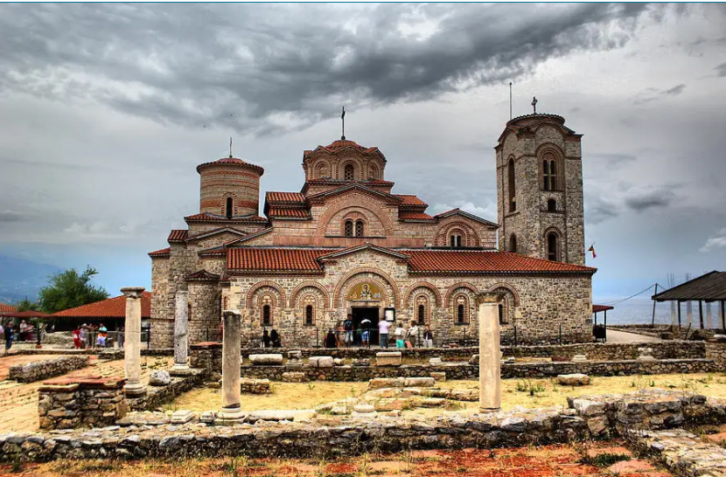
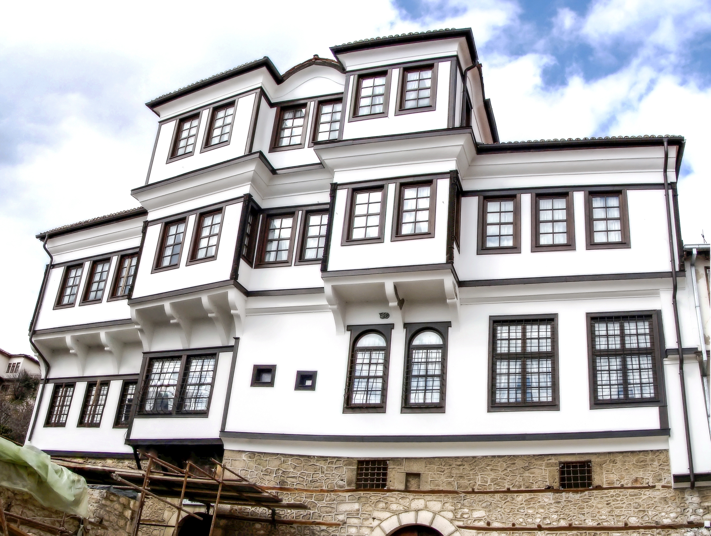
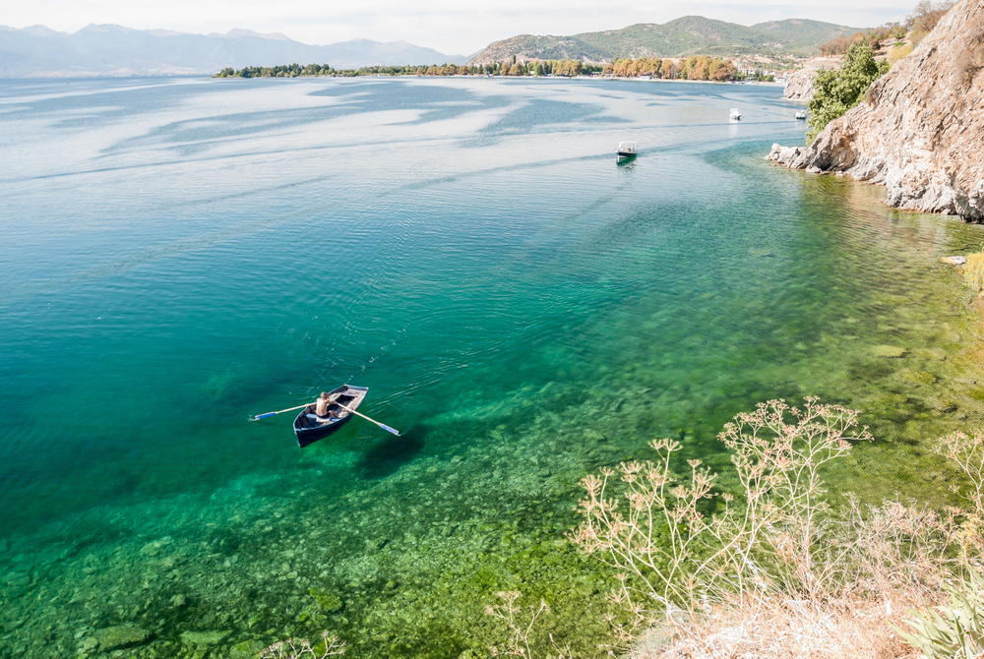
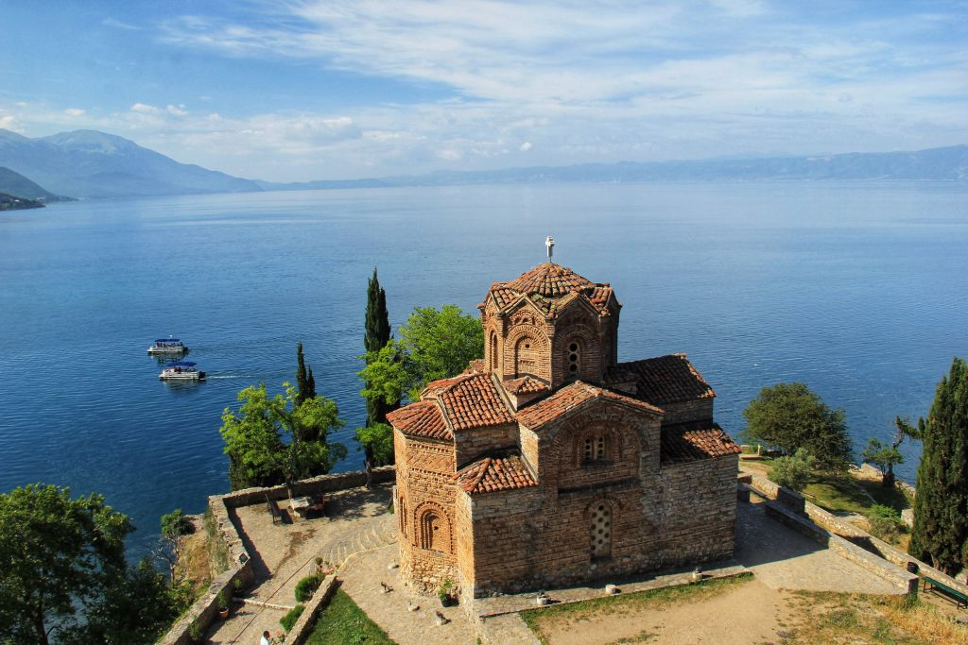
Puzzle time
Plaošnik
Robevi Family House
Ohrid Lake
Church of St. John at Kaneo

Slide 12
Pictionary is word-guessing game!
Instructions
One of the hosts will share a whiteboard where everyone would be able to draw to something.
1. You will be given a category where you can choose word from
2. One person a time to draws their chosen word.
3. The first person who recognizes the drawing can raise their hand and will get chance to guess the answer.
4. After someone guesses the word, give us an explanation why you chose that word.
Activity 3:Pictionary

Slide 13
Movies!
Your category is:
Notice: If this category is too difficult for you, you can choose TV show, game or anything else you would like!

Slide 14
THANKS
Did you have fun today?
Thank you for your hard work
and hope you enjoyed his workshop!
We wish you successful work in your committee!
share your instagram and facebook profiles to get to know your new friends even better.

